Slide 1



Crypto 101
Oded Vanunu
Dikla Barda
Roman Zaikin
Liad Mizrachi

Slide 2


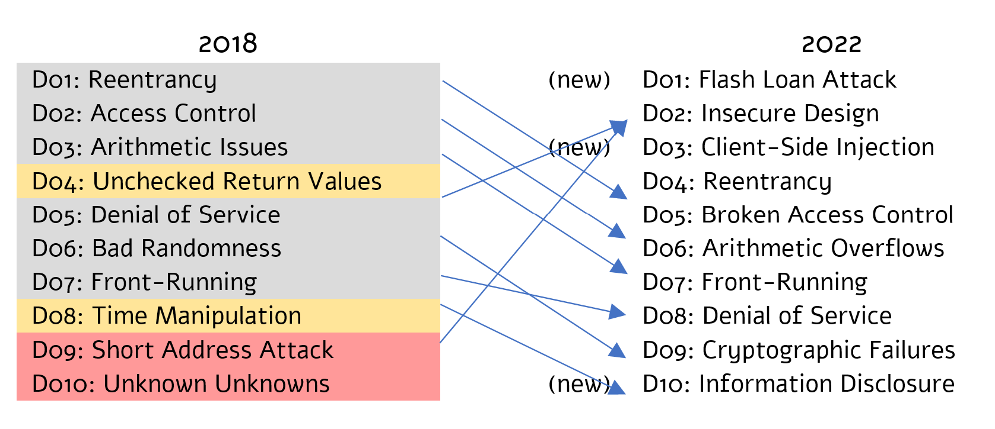
dApps TOP 10
The DAPPS Top 10 is a standard awareness document for blockchain developers and blockchain security teams. It represents a broad consensus about the most critical security risks to blockchain.
research.checkpoint.com
Notes:
https://www.blockchain.com/btc/unconfirmed-transactions

Slide 3
How blockchain attack looks like?
The attacks in the crypto are divided into 2:
Intended scam contract, aim to steal your funds by design.
Unintended Hacked project by a blockchain security vulnerability.
research.checkpoint.com

Slide 4
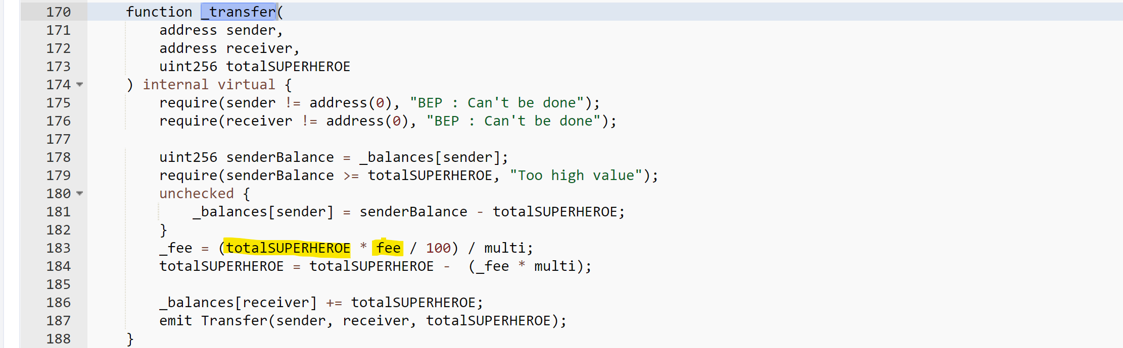
Scam Contract Example 1:
BscScan Link: https://bscscan.com/address/0x8ed9c7e4d8dfe480584cc7ef45742ac302ba27d7#code
research.checkpoint.com

Slide 5
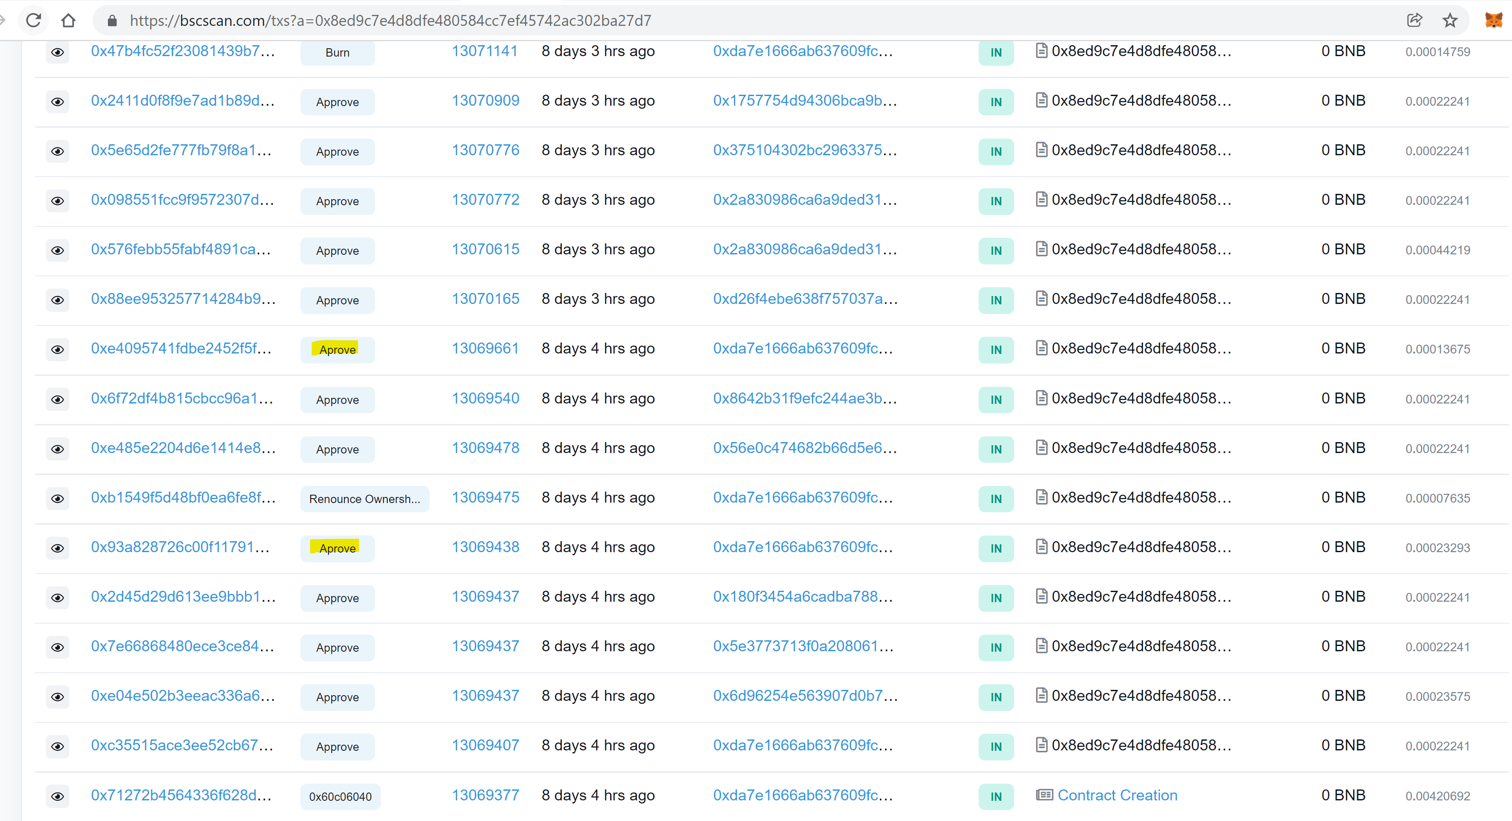
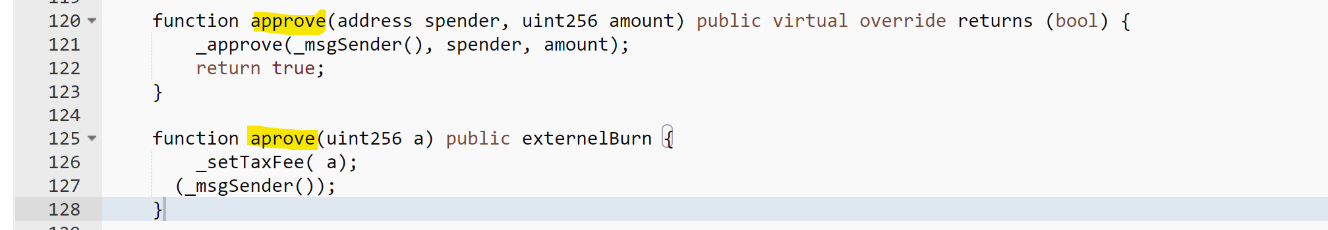
Scam Contract Example 1:
BscScan Link: https://bscscan.com/address/0x8ed9c7e4d8dfe480584cc7ef45742ac302ba27d7#code
research.checkpoint.com

Slide 6
Scam Contract Example 2:
Auto generated scam:
No One Can Swap ! Except Your White-list Addresses .
You can Create unlimited Tokens with the Same HoneyPot Smart Contract .
Our HoneyPot Contract Can’t be Detected By Scam Scanners Websites .
Because of No one can Sell! It's just going up and up for a massive Bullish That Attract Buyers without thinking twice.
https://honeypot-crypto.com
research.checkpoint.com

Slide 7
Blockchain Security Vulnerability
Most security vulnerabilities in Crypto happen when the contract developer is unaware of the side effects of their code or blockchain fundamentals.
Knowing how to program is not enough in Crypto, you have to understand the infrastructure.
research.checkpoint.com

Slide 8
Testnet vs Mainnet
A testnet only exists as a working prototype for a blockchain project, while a mainnet is a completely developed blockchain platform for users to send and receive cryptocurrency transactions.
https://etherscan.io
https://rinkeby.etherscan.io
research.checkpoint.com

Slide 9
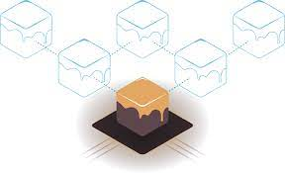
Ganache the Personal Blockchain
Ganache is a personal blockchain for Ethereum distributed application development. You can use Ganache across the entire development cycle; enabling you to develop, deploy, and test your dApps in a safe and deterministic environment.
Brownie is a Python-based development and testing framework for smart contracts, brownie emulate blockchain development and testing on ganache.
research.checkpoint.com

Slide 10
D01 – Flash Loan
DeFi refers to financial applications built on blockchain technology that enable digital transactions between multiple parties. The blockchain is essentially a public ledger for digital assets, including cryptocurrencies. DeFi can involve lending crypto, sending crypto, or stake crypto.
https://research.checkpoint.com/2022/airdrop-process-of-apecoin-cryptocurrency-found-vulnerable-led-to-theft-of-millions-of-dollars-in-nfts/
research.checkpoint.com

Slide 11
D01 – Flash Loan Attack
A Flash loan is a method of lending and returning the loan on a single transaction in the blockchain network.
In practice, the borrower has to return the loan before the end of the block (which takes a few seconds), and failing to do so, the loan will fail and the money will be returned to the loner.
research.checkpoint.com

Slide 12
D01 – Flash Loan Attack
Demo using the Flash Loan Contract:
WhoIsTheOwner
Hack Defi
https://www.cnbc.com/2021/11/19/over-10-billion-lost-to-defi-scams-and-thefts-in-2021.html
research.checkpoint.com

Slide 13
D01 – Flash Loan Attack
How to stay protected?
Never rely on a balance, don't try to convince people to invest more for benefits.
Deposited balance may easily get withdrawn, don't encourage invest more by bonuses for investment. The attacker will steal just the bonus.
research.checkpoint.com

Slide 14
D02 - Smart Contract Insecure Design
Smart contracts are a relatively new technology and application development through smart contracts is less common compared to website development.
Due to the lack of knowledge and lack of an methodology, many Contracts contains a logical bugs that cause the contract to be breached.
research.checkpoint.com

Slide 15
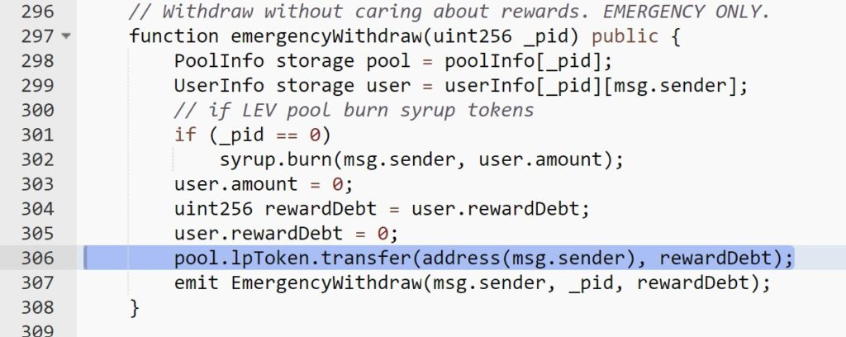
D02 - Smart Contract Insecure Design
For example Levyathan Protocol Hack:
https://levyathan-index.medium.com/post-mortem-levyathan-c3ff7f9a6f65
research.checkpoint.com

Slide 16
D02 - Smart Contract Insecure Design
Rules of thumb for the crypto developers:
Keep the code of the smart contract as simple as possible.
Do not put information that is not relevant to the smart contract operation into your code.
Make sure you have a way in the contract to fix a bug in the code.
research.checkpoint.com

Slide 17
D03 - Client-Side Code Injections
Client-side code injection attacks are very popular among websites, in this attack the attacker finds a way to inject malicious script that executes JavaScript code.
And if the victim using an Extension based wallet, this JavaScript code can easily hack your wallet and steal all your funds via a single transaction.
research.checkpoint.com

Slide 18
D03 - Client-Side Code Injections
For example, badgers Dao hacked for 130m with a simple XSS:
https://www.coindesk.com/tech/2021/12/16/after-130m-hack-badgers-restitution-plan-tests-limits-of-dao-governance/
https://zengo.com/the-badgerdao-hack-what-really-happened-and-why-it-matters/
Or our research at OpenSea, we have created an NFT which could steal all your funds:
https://research.checkpoint.com/2021/check-point-research-prevents-theft-of-crypto-wallets-on-opensea-the-worlds-largest-nft-marketplace/
research.checkpoint.com

Slide 19
D03 - Client-Side Code Injections
How to stay protected?
Understand what you are signing, never sign something you do not know.
research.checkpoint.com

Slide 20
D04 - Reentrancy
A reentrancy attack occurs when a function makes an external call to another untrusted contract. Then the untrusted contract makes a recursive call back to the original function in an attempt to drain funds.
research.checkpoint.com

Slide 21
D04 - Reentrancy
Companies that got hacked by reentrancy:
https://cryptopotato.com/over-80-million-stolen-from-defi-lender-rari-capital/
https://cointelegraph.com/news/defi-protocol-grim-finance-lost-30m-in-5x-reentrancy-hack
https://www.coindesk.com/tech/2022/04/01/ola-finance-says-attackers-stole-47m-in-re-entrancy-exploit/
research.checkpoint.com

Slide 22
D04 - Reentrancy
Demo using:
Single
research.checkpoint.com

Slide 23
D04 - Reentrancy
How to Protect from Reentrancy:
modifier nonReentrant() { require(_status != _ENTERED, "ReentrancyGuard"); _status = _ENTERED;
_;
_status = _NOT_ENTERED; }
https://github.com/OpenZeppelin/openzeppelin-contracts/blob/master/contracts/security/ReentrancyGuard.sol
research.checkpoint.com

Slide 24
D04 - Reentrancy
Demo using:
Multi
research.checkpoint.com

Slide 25
D04 - Reentrancy
How to stay protected?
Make sure to Zero the balance before you transfer it!
balances[msg.sender] = 0; require(bal > 0, "No balance to withdraw"); (bool sent, ) = msg.sender.call{value: bal}("");
research.checkpoint.com

Slide 26
D05 - Broken Access Control
A successful exploit of a broken access control vulnerability often occurs when resources are not protected through proper configurations or when protection mechanisms are not enforced correctly.
Often these issues are undocumented behavior, or improper implementation of desired behavior.
research.checkpoint.com

Slide 27
D05 - Broken Access Control
DelegateCall, as the name implies, is calling mechanism of how caller contract calls target contract function but when target contract executed its logic, the context is not on the contract who execute caller contract but on caller contract itself.
research.checkpoint.com

Slide 28
D05 - Broken Access Control
Demo using:
Example
Calc
research.checkpoint.com

Slide 29
D05 - Broken Access Control
How to stay protected?
If you are using a DelegateCall, make sure to configure the same slot variables in your contract
research.checkpoint.com

Slide 30
D06 - Arithmetic Overflows
In computer programming, an integer overflow occurs when an arithmetic operation attempts to create a numeric value that is outside of the range that can be represented with a given number of digits – either higher than the maximum or lower than the minimum representable value.
research.checkpoint.com

Slide 31
D06 - Arithmetic Overflows
Demo using:
Overflow_demo
Disperse - https://etherscan.io/address/0xd152f549545093347a162dce210e7293f1452150
research.checkpoint.com

Slide 32
D06 - Arithmetic Overflows
How to protect from Arithmetic Overflows?
Use solidity version 8.0.0+
Use SafeMath (Works for uint256)
research.checkpoint.com

Slide 33
D07 - Front-Running
Front running is the act of placing a transaction in a queue with the knowledge of a future transaction. Front running on a blockchain platform normally happens when a miner, who has access to information on pending transactions, places an order that would earn him a profit based on a pending trade.
research.checkpoint.com

Slide 34
D07 - Front-Running
Demo front running on mainnet:
Video
https://opensea.io/collection/nft-idiots-club
research.checkpoint.com

Slide 35
D08 - Denial of Service
While other types of applications and systems in the tech world can eventually recover from a Denial of Service attack, in smart contracts the situation is different, due to the fact that a contract code cannot be changed if an attacker manages to put our contract into a Denial of Service state in most cases the money will get stuck in the contract forever.
research.checkpoint.com

Slide 36
D08 - Denial of Service
Denial of Service Story:
https://cointelegraph.com/news/akudreams-dev-team-locks-up-34m-due-to-smart-contract-bug
https://etherscan.io/address/0xf42c318dbfbaab0eee040279c6a2588fa01a961d
require(refundProgress >= totalBids, "Refunds not yet processed");
research.checkpoint.com

Slide 37
D08 - Denial of Service
How to stay protected:
Same as Flash Loan, never relay on balance!
Balance can be borrowed or transferred via various ways!
research.checkpoint.com

Slide 38
D09 - Cryptographic Failures
Therefore, a Cryptographic Failure vulnerability is a broad vulnerability category that encompasses all types of attacks that are related to anything cryptography related. As one could imagine, a vulnerability of this type could lead to serious consequences, as cryptography is meant to secure sensitive information.
research.checkpoint.com

Slide 39
D09 - Cryptographic Failures
Cryptographic Failures Demo:
Register to https://infura.io/
brownie run d07_random_number --network rinkeby
Random number
Practice:
chal: https://rinkeby.etherscan.io/address/0xe8C55f0B2EBE03Cc7de0110e2d0ed2D2E3cd8c46
research.checkpoint.com

Slide 40
D09 - Cryptographic Failures
How to protect from Cryptographic Failures?
Don’t use on chain data for cryptography (block, tx, msg) are all visible and stored on chain.
research.checkpoint.com

Slide 41
D10 - Information Disclosure
As we have mentioned many times and we are sure you have already understood this, once the data is in Blockchain, it is stored there forever. The blockchain is a permanent, unchangeable storage.
Also all the state variables that stored in the contract are also stored on the blockchain within a data structure called a slot.
research.checkpoint.com

Slide 42
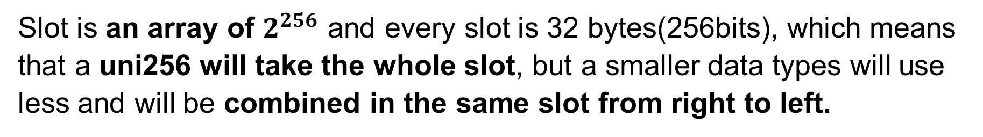
D10 - Information Disclosure
Slot is an array of $2^{256}$ and every slot is 32 bytes(256bits), which means that a uni256 will take the whole slot, but a smaller data types will use less and will be combined in the same slot from right to left.
contract MyData { address private owner = msg.sender; uint32 private age = 33; bytes32 private password; uint256 private constant constantData = 1337; uint256 private secret = 123; constructor(bytes32 _password) { password = _password; } }
owner 20 bytes | Age 4 bytes
Password 32 bytes
Secret 32 bytes
research.checkpoint.com

Slide 43
D10 - Information Disclosure
Demo:
Information disclosure
Random number on rinkeby
research.checkpoint.com

Slide 44
D10 - Information Disclosure
How to stay protected?
Never store something sensitive on the blockchain.
research.checkpoint.com

Slide 45

THANK YOU

